Slide 1
Different Image Formats

Slide 2
What is the image-based formats?
Image Format describes how data related to the image will be stored.
Data can be stored in :
compressed,
Uncompressed or
vector format.
Each format of the image has a different advantage and disadvantage.

Slide 3
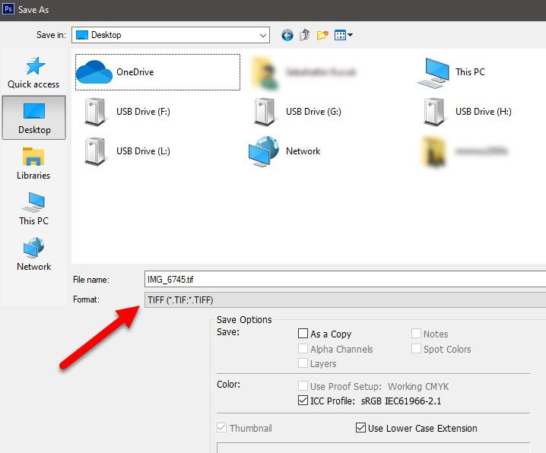
TIFF(.tif, .tiff)
Tagged Image File Format this format store image data without losing any data.

Slide 4
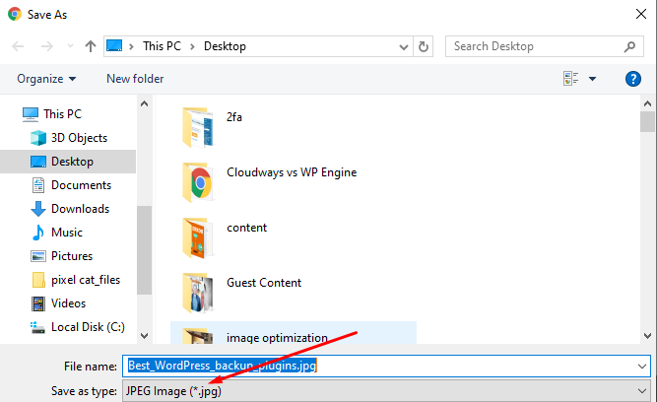
JPEG (.jpg, .jpeg)
Joint Photographic Experts Group is a loss-prone (lossy) format in which data is lost to reduce size of image.
Due to compression, some data is lost but that loss is very less.

Slide 5
GIF (.gif)
GIF or Graphics Interchange Format files are used for web graphics.
They can be animated and are limited to only 256 colors, can allow for transparency.
GIF files are typically small is size and are portable.

Slide 6

PNG (.png)
PNG or Portable Network Graphics files are a lossless image format.
It was designed to replace gif format as gif supported 256 colors unlike PNG which support 16 million colors.

Slide 7
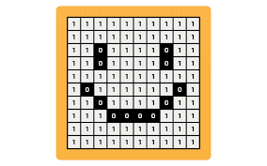
Bitmap (.bmp)
Bit Map Image file is developed by Microsoft for windows.
Due to BMP being a proprietary format, it is generally recommended to use TIFF files.

Slide 8
File format extensions for image files
Below is a list of the most common image file extensions.
• .ai - Adobe Illustrator file
• .bmp - Bitmap image
• .gif - GIF image
• .ico - Icon file
• .jpeg or .jpg - JPEG image
• .png - PNG image
• .ps - PostScript file
• .psd - PSD image
• .svg - Scalable Vector Graphics file
• .tif or .tiff - TIFF image

Slide 9
Advantages of
compressing files

Slide 10
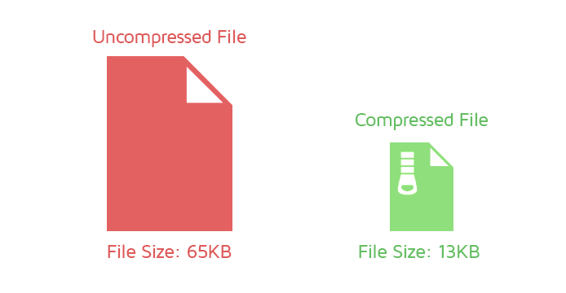
What Is a Compressed File?
A compressed file is any file which is smaller than its original size and could contain one or more files, or even a directory.
Compressed files have the advantage of being faster to transmit and download, and can allow more data to be stored in physical or removable media.

Slide 11

Why Compress Files?
Compressing is mainly used for the following purposes:
A compressed file takes up less storage space. A smaller file can be transferred faster between locations e.g., on the Internet.
The file icon or the .zip extension will tell you that a file is compressed.

Slide 12
Types of Compression
Compressed files usually end with.zip, sit and .tar.
These are called extensions, and they indicate different compression formats--different types of software used to compress files.
For PCs, .zip is most common, sit is used often with Macs and .tar used with Linux.
Lossless Compression
Lossy Compression
Decompression

Slide 13
Advantages of File Compression
Advantage of lossy data compression
Significant reduction of file size but at the cost of loss in the quality.
Tools available help in choosing the level of compression.
Advantages of lossless data compression
Slight reduction in image file size can be achieved without loss in the image quality.

Slide 14
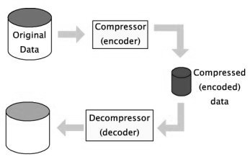
Advantages of Decompression data compression

Slide 15
Distinguish between backup and cloning

Slide 16
What is Backup?
Backup is the process of creating a copy of the data on your system that you use for recovery in case your original data is lost or corrupted. You can also use backup to recover copies of older files if you have deleted them from your system.

Slide 17
What is cloning?
Cloning is also used to describe the act of making the exact copy of a directory file or disk inclusive of any subdirectories or files within the disk or directory.
Cloning a hard drive comes with several benefits that make it an easy way to get the most out of your storage solutions.

Slide 18
Thank You

